Slide 1
DOA Budget Hearing
May 11, 2026

Slide 2
2026 – 2027 Priorities
Improve Financials Monitoring Tools with introduction of Budget Vs Actuals (Federal Expenditures – Fund 101) Reporting for Line Agencies, in addition to similar report for the General Fund introduced in 2025.
Pursue enabling of Direct Debit (ACH Pull) for Tax Payments to support DRT with Tax Collection.
Finalize Financial Statements Capability to ensure timely provision of Financial Statements for Annual Budget Reviews and to meet Audit timelines.
Complete migration of All Line Agencies, Semi-Autonomous Agencies to paperless Payroll System.
Implement AI driven recruitment application evaluation system and paperless interview notification system.
Centralization of Procurement enhanced compliance, standardization, and purchasing effectiveness across departments.
Modernization of Surplus Property and Inventory Management through the establishment of tracking systems, increased reuse across departments, expansion of surplus sales, and improved purchasing of supplies for the government store to maximize value, reduce waste, and strengthen operational efficiency.
Better utilization of GFMIS with focus on resolving issues flagged via User’s Service Requests and implement process improvements and progress completion remaining modules.
Multi-Year contracting for the Third-Party Administrators (TPA).
Issuance of the life insurance RFP, contractual award, and change in statute to increase the Basic 10k.
Optimize Medical Enrollment of Medicare Eligible and Non-Medicare eligible subscribers.

Slide 3
2026 - 2027 Challenges
As procurement workload continues to grow, allocating adequate resources is critical to improve turnaround times.
The achievement of a unified digital records management system remains a key a challenge as we strive to improve accessibility, strengthen data security, and meet compliance requirements across departments.
Management of Federal Grants with additional requirements, justification of expenditures and with restricted access.
Continued efforts to support Line Agencies better manage payment, procurement and recruitment process.
Timely and Accurate Reporting from Agencies regarding Insurance enrollment, terminations and payments.
Centralization of Insurance processing of Defined Contribution Retirees and Survivors.
Separation of senior staff and succession plan implementation.
Availability of qualified and experienced professionals for specialized roles required to resource the Department of Administration.

Slide 4
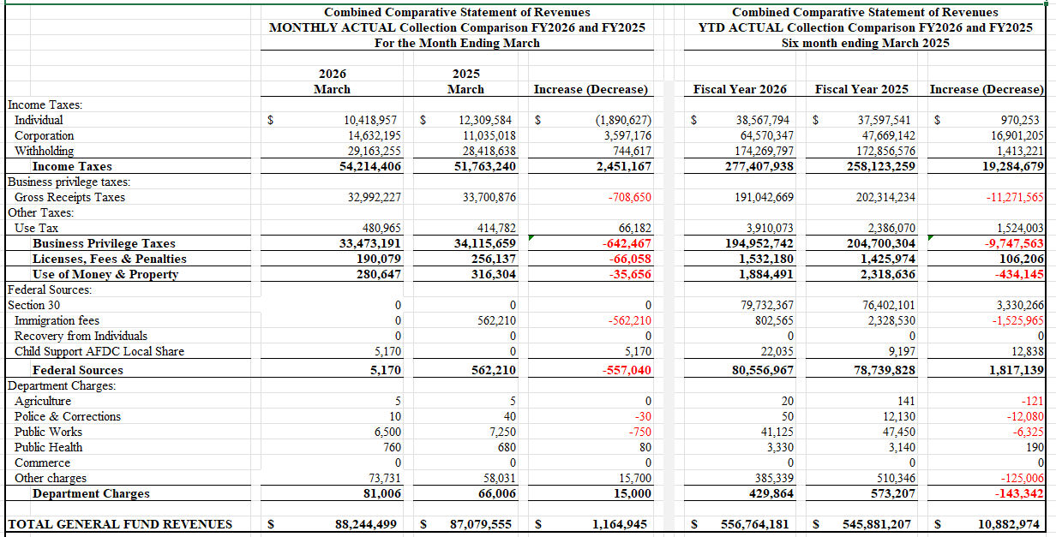
1H2026 General Fund Revenues

Slide 5
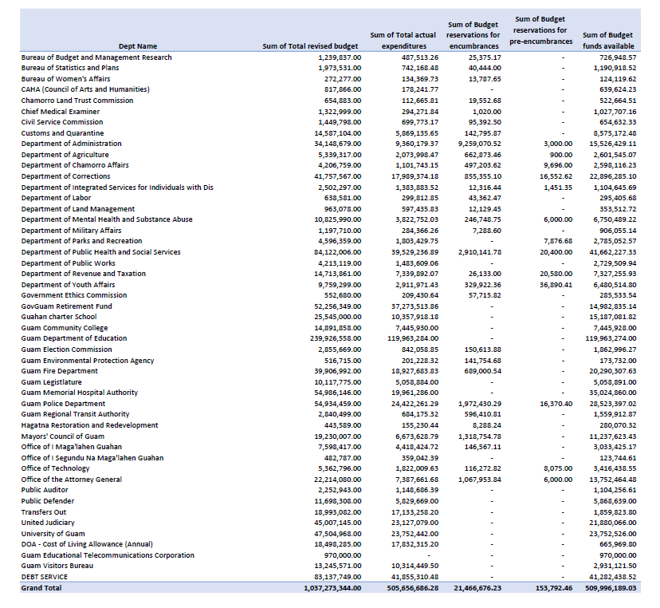
1H2026 General Fund Expenditures

Slide 6
FY27 Budget Request

Slide 7
FY2026 DOA Activities
 | 1H2026
 | No (#) | Value ($$)
Treasurer of Guam Collections | 266,530 | 493,366,709
Invoices & Direct Payments | 41,574 | 557,814,544
Purchase Orders
Requisitions

